Slide 1

Frontiers of Network Science
Fall 2023
Class 2: Graph Theory
(Chapter 2 in Textbook)
Boleslaw Szymanski
based on slides by Albert-László Barabási & Roberta Sinatra

Slide 2
Topic Choices for Grad Projects
1. Quantifying the future lethality of terror organizations, Yang Yang, Adam R Pah, Brian Uzzi, Proc. the Nat. Acad. of Sci. 116(43):21463–21468 (2019)
2. The universal decay of collective memory and attention, C. Candia, C. Jara-Figueroa, C. Rodriguez-Sickert, A.-L. Barabási, C. A Hidalgo, Nature Human Behaviour, 3:82–91 (2019)
3. Quantifying reputation and success in art, Samuel P. Fraiberger, Roberta Sinatra, Magnus Resch, Christoph Riedl, Albert-László Barabási, Science, 362:825–829 (2018)
4. Experimental evidence for tipping points in social convention, Damon Centola, Joshua Becker, Devon Brackbill, Andrea Baronchelli, Science, 360:1116–1119 (2018)
5. Scientific prize network predicts who pushes the boundaries of science, Yifang Ma, Brian Uzzi, Proceedings of the National Academy of Sciences 115(50):12608-12615 (2018)
6. Quantifying patterns of research-interest evolution, Tao Jia, Dashung Wang, Boleslaw K. Szymanski Nature Human Behaviour 1(4):0078, (2017)
7. Quantifying the evolution of individual scientific impact, Roberta Sinatra, Dashun Wang, Pierre Deville, Chaoming Song, Albert-László Barabási, Science 354(6312):5239 (2016)

Slide 3
8. Universal resilience patterns in complex networks, Jianxi Gao, Baruch Barzel, Albert-László Barabási, Nature 530(7590):307 (2016)
9. Human symptoms–disease network, Human, XueZhong Zhou, Jörg Menche, Albert-László Barabási, Amitabh Sharma, Nature Communications 5(4212) (2014)
10. A network framework of cultural history, Maximilian Schich, Chaoming Song, Yong-Yeol Ahn, Alexander Mirsky, Mauro Martino, Albert-László Barabási, Science 345 (6196):558-562 (2014)
11. Quantifying Long-Term Scientific Impact, Dashun Wang, Chaoming Song, Albert-László Barabási, Science 342 (6154):127-132 (2013)
12. A universal model for mobility and migration patterns, Filippo Simini, Marta C. González, Amos Maritan, Albert-László Barabási, Nature 484:96–100 (2012)
13. Controllability of complex networks, Yang-Yu Liu, Jean-Jacques Slotine, Albert-László Barabási, Nature 473:167–173 (2011)
14. Limits of Human Mobility, Chaoming Song, Zehui Qu, Nicholas Blumm, Albert-László Barabási1, Science 327(5968):1018-1021 (2010)
15. Understanding individual human mobility patterns, Marta C Gonzalez, Cesar A Hidalgo, Albert-Laszlo Barabasi, Nature, 453 (7196):779—782 (2008)

Slide 4
16. The product space conditions the development of nations, Cesar A Hidalgo, Bailey Klinger, Albert-László Barabási, Ricardo Hausmann, Science 317 (5837):482-487 (2007)
17. Dynamics of ranking, Gerardo Iniguez, Carlos Pineda, Carlos Gershenson, Albert-László Barabási, Nature Communications 13 (7):1-7 (2022)
18. Polarization and tipping points, Michael W. Macy, Manqing Ma, Daniel R. Tabin, Jianxi Gao, Boleslaw K. Szymanski. Proc. the Nat. Acad. of Sci., 118(50):e2102144118, (2021)
19. Polarized information ecosystems can reorganize social networks via information cascades, Christopher K. Tokita, Andrew M. Guess, Corina E. Tarnita, Proc. the Nat. Acad. of Sci., 118(50):e2102147118, (2021)
20. Political polarization of news media and influencers on Twitter in the 2016 and 2020 US presidential elections, James Flamino, Alessandro Galeazzi, Stuart Feldman, Michael W. Macy, Brendan Cross, Zhenkun Zhou, Matteo Serafino, Alexandre Bovet, Hernan A. Makse, & Boleslaw K. Szymanski, Nature Human Behaviour 7, March 13, 2023. https://doi.org/10.1038s41562-023-01550-8
21. Creation, Evolution, and Dissolution of Social Groups, James Flamino, Boleslaw K. Szymanski, Ashwin Bahulkar, Kevin Chan, and Omar Lizardo, Scientific Reports 11:17470, (2021)

Slide 5


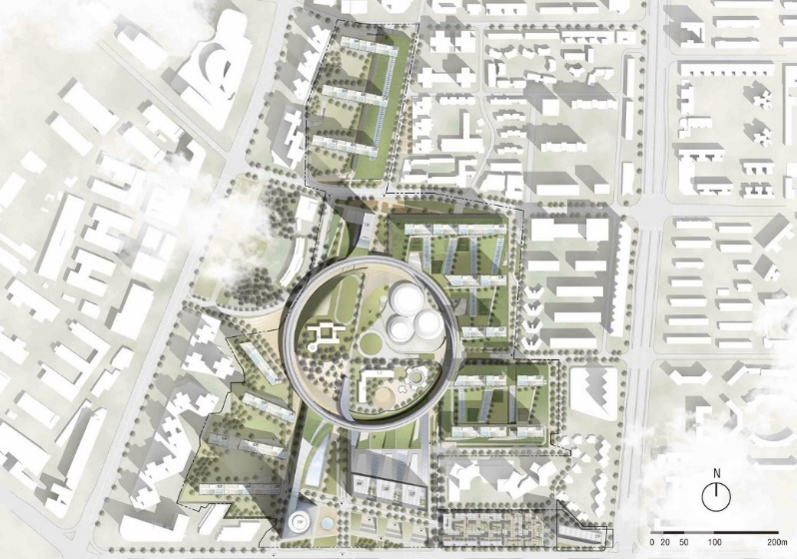


Limits of Predictability in Human Mobility
Motivation: Why do people study human mobility?
Urban planning and traffic forecasting
Mobile resource management
Spread of infectious diseases
Spread of electronic viruses
Notes:
Humans are mobile creatures, travelling large distances for work, school, and entertainment.
Understanding and predicting human mobility is important in areas such as urban planning and traffic forecasting, the spread viruses (human and electrical), and resource management in mobile communication. These applications, and many others, depend on our abilities to foresee the mobility of individuals.

Slide 6
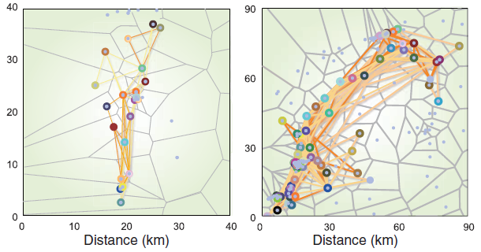
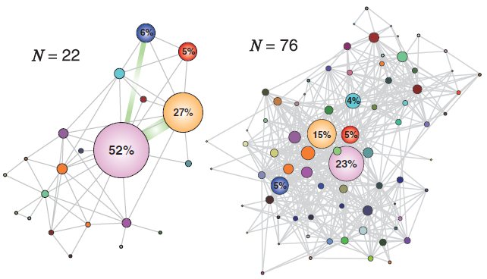
Limits of Predictability in Human Mobility
Data
A
B
22 vicinities
76 vicinities
The trajectories of two users
User’s mobility networks

Slide 7
Quantifying patterns of research-interest evolution
Motivation
Microscopic factors extensively studied
  Personality traits
  Risk aversion
  Training and mentorship
  Funding or collaboration opportunities
  Age
Research into macroscopic patterns limited
Researcher’s interest evolution best captured through papers published

Slide 8
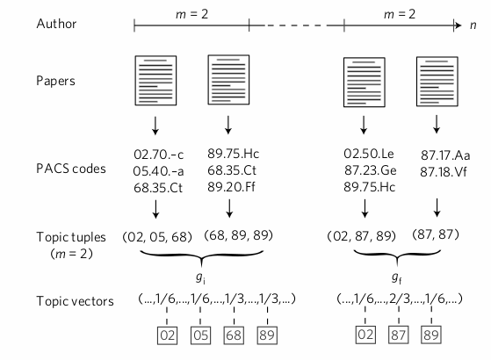
Quantifying patterns of research-interest evolution
Data
Uses APS data base
Transform PACS codes to Topic Vector

Slide 9
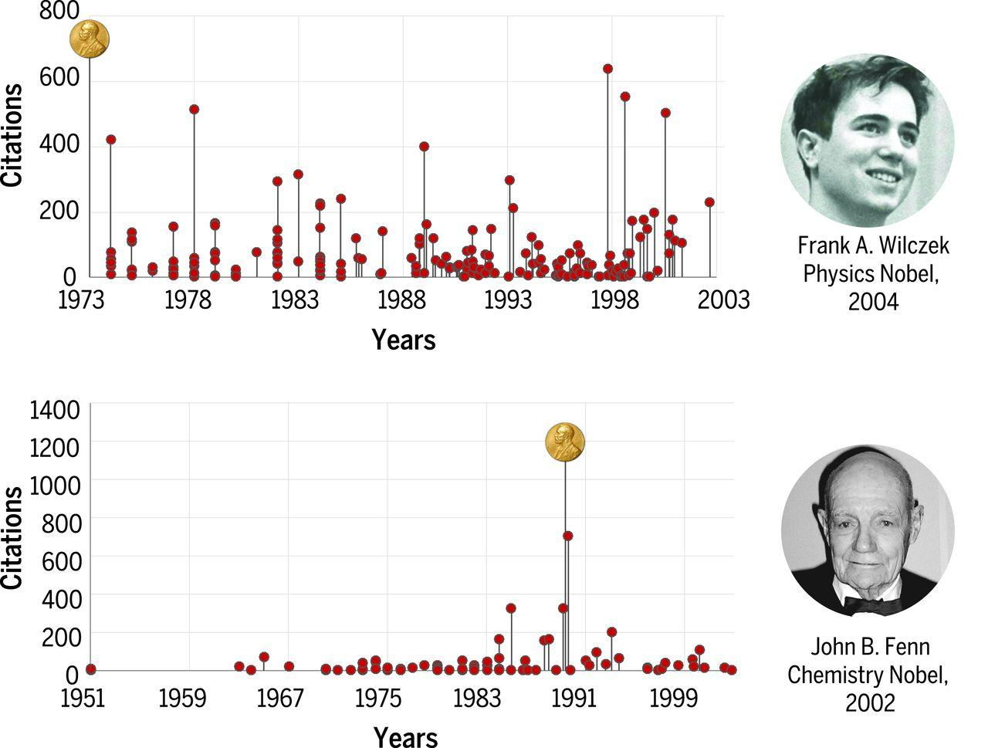
Quantifying the evolution of individual scientific impact
Random-impact model (R-Model)
Highest impact work can occur at any point in a scientist’s career regardless of field, collaborators, and productivity. Null model for determining how a scientist’s individual ability affect the quality of scientific work.

Slide 10
A Network Framework for Cultural History
A network framework of cultural history
Data sources, coverage in time and space

Slide 11
Prominent people are born everywhere but they die in prominent places
Why?
You cannot choose where you are born but you can choose where you die

Slide 12
Polarization and tipping points
Importance of the exogenous shock

Slide 13
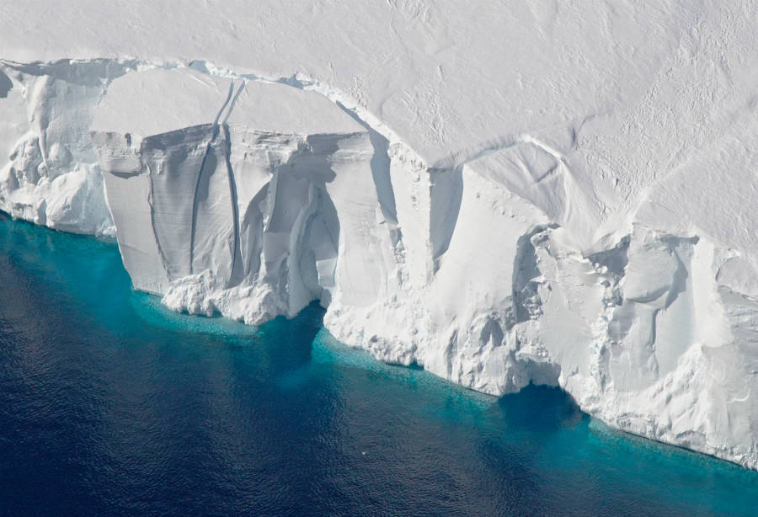
Motivation
Free Topic: Ice-Sheet Meshes and Biconnectivity
https://insideclimatenews.org/sites/default/files/styles/icn_full_wrap_wide/public/getz-ice-shelf_jeremy-harbeck-nasa.jpg?itok=D1uLzpFu

Slide 14
Ice-Sheet Meshes and Biconnectivity
Background
Biconnectivity
  Articulation points
Meshes
  Potential articulation points
  “Double hinges”
The Ice-Sheet problem
Modeling Antarctic Ice-Sheet
“Grounding”
Degenerate Features
Similar to Biconnectivity

Slide 15
Free Topic: Links between Startups and Venture Capital in China

Slide 16
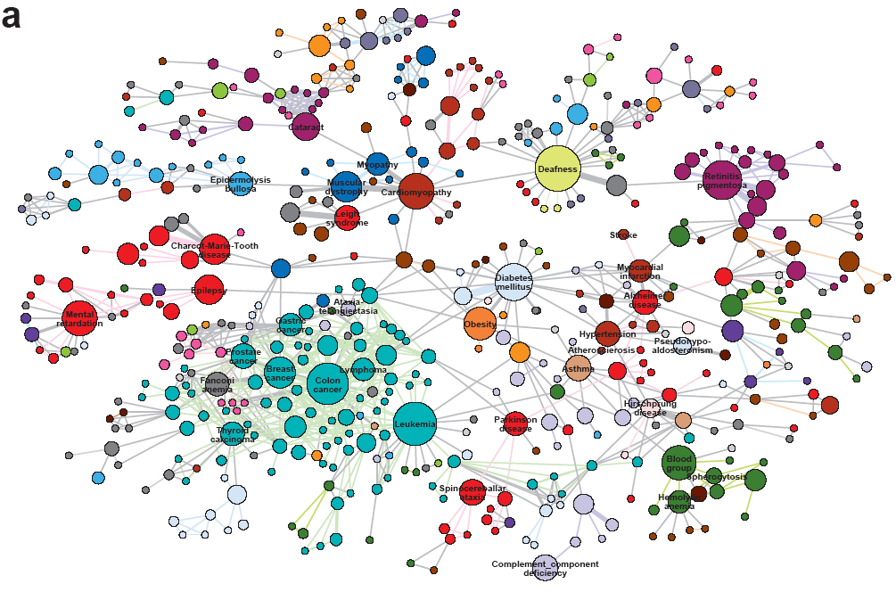
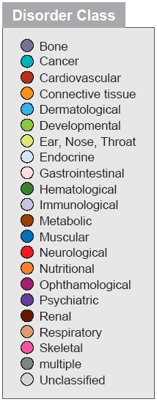
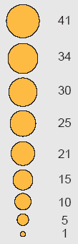
HUMAN DISEASE NETWORK
Notes:
Health: From drug design to metabolic engineering.
The human genome project, completed in 2001, offered the first comprehensive list of all human genes [9, 10]. Yet, to fully understand how our cells function, and the origin of disease, we need accurate maps that tell us how these genes and other cellular components interact with each other. Most cellular processes, from the processing of food by our cells to sensing changes in the environment, rely on molecular networks. The breakdown of these networks is responsible for most human diseases. This has led to the emergence of network biology, a new subfield of biology that aims to understand the behavior of cellular networks. A parallel movement within medicine, called network medicine, aims to uncover the role of networks in human disease (Image 1.7a/b). Networks are particularly import- ant in drug development. The ultimate goal of network pharmacology is to develop drugs that can cure diseases without significant side effects. This goal is pursued at many levels, from millions of dollars invested to map out cellular networks to the development of tools and databas- es to store, curate, and analyze patient and genetic data. Several new companies take advantage of these opportuni- ties, from GeneGo that aims to collect accurate maps of celllular interactions from scientific literature to Genomatica that uses the predictive power behind metabolic networks to identify drug targets in bacteria and humans. Recently most major pharmaceutical companies have made significant investments in network and systems medicine, seeing it as the path towards future drugs.

Slide 17


Network Biology/Network Medicine
Notes:
Networks in biology and medicine.
a) The cover of two issues of Nature Reviews Genetics, the top review journal in genetics. The cover from 2004, focuses on network biology [11], the cover from 2011 discuses network medicine [12].
b) The prominent role networks play in both cell biology and medical research is illustrated by the fact that the 2004 article on network biology is the second most cited article in the history of Nature Reviews Genetics.

Slide 18



FIGHTING TERRORISM AND MILITARY
http://www.slate.com/id/2245232
Network Science: Introduction
Notes:
Security: Fighting Terrorism.
Terrorism is one of the maladies of the 21st century, absorbing significant resources to combat it worldwide. Network thinking is increasingly present in the arsenal of various law enforcement agencies in charge of limiting terrorist activities. It is used to disrupt the financial network of terrorist organizations, to map terrorist networks, and to uncover the role of their members and their capabilities. While much of the work in this area is classified, several success stories have surfaced. Examples include the use of social networks to capture Saddam Hussein or the capture of the individuals behind the March 11, 2004 Madrid train bombings through the examination of the mobile call net- work.

Slide 19
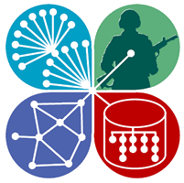

FIGHTING TERRORISM AND MILITARY
http://www.ns-cta.org/ns-cta-blog/
Network Science: Introduction
Notes:
Network concepts have impacted military doctrine as well, leading to the concept of net-war, aimed at fighting low intensity conflicts and crime waged by terrorist and criminal networks that employ decentralized flexible net- work structures [13]. One of the first network science pro- grams at the college level was started at West Point, the US Army’s military academy. In 2009 the Army Research Lab and the Department of Defense devoted over $300 million to support network science centers across the US.

Slide 20
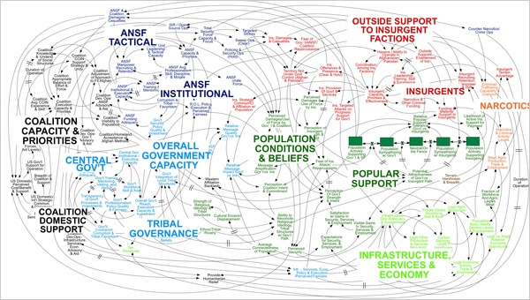
The network behind a military engagement
Network Science: Introduction
Notes:
The network behind a military engagement.
This diagram was designed during the Afghan war to portray the American strategy in Afghanistan. While it has been occasionally ridiculed in the press, it portrays well the complexities and the interconnected nature of a military’s engagement. (Image from New York Times)

Slide 21
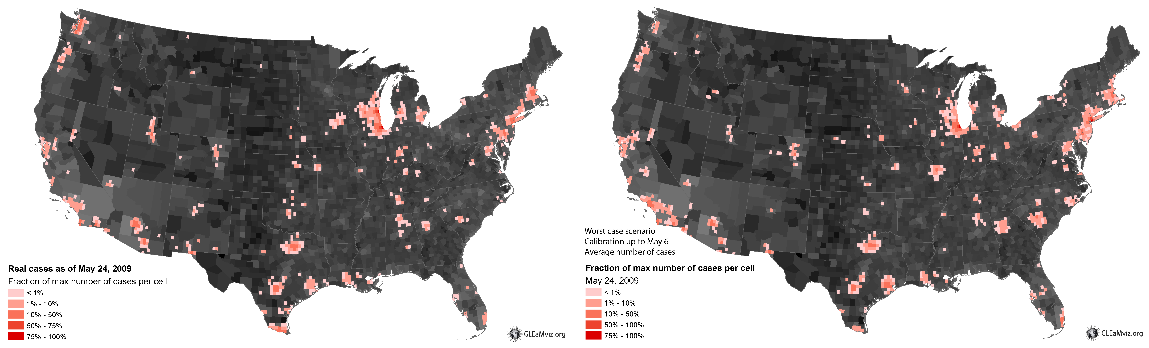
EPIDEMIC FORECAST Predicting the H1N1 pandemic
Real
Projected
Network Science: Introduction
Notes:
Epidemics: From forecasting
to halting deadly viruses.
While the H1N1 pandemic was not as devastating as it was feared at the beginning of the outbreak in 2009, it gained a special role in the history of epidemics: it was the first pandemic whose course and time evolution was accurately predicted months before the pandemic reached its peak (Image 1.9). This was possible thanks to fundamental advances in understanding the role of networks in the spread of viruses. Indeed, before 2000 epidemic modeling was dominated by compartment models, assuming that everyone can infect everyone else one word the same socio-physical compartment. The emergence of a net- work-based framework has fundamentally changed this, offering a new level of predictability in epidemic phenomena.
Today epidemic prediction is one of the most active applications of network science [15, 16]. It is the source several fundamental results, covered in this book, that are used to predict the spread of both biological and electronic viruses. The impact of these advances are felt beyond biological viruses. In January 2010 network science tools have predicted the conditions necessary for the emergence of viruses spreading through mobile phones [17]. The first major mobile epidemic outbreak that started in the fall of 2010 in China, infecting over 300,000 phones each day, closely followed the predicted scenario.

Slide 22
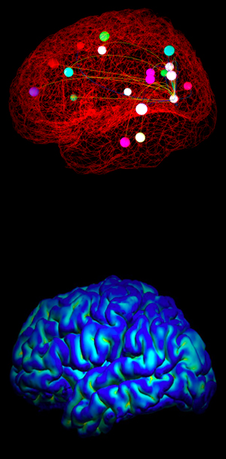
Thex
BRAIN RESEARCH
In September 2010 the National Institutes of Health awarded $40 million to researchers at Harvard, Washington University in St. Louis, the University of Minnesota and UCLA, to develop the technologies that could systematically map out brain circuits.
The Human Connectome Project (HCP) with the ambitious goal to construct a map of the complete structural and functional neural connections in vivo within and across individuals.
http://www.humanconnectomeproject.org/overview/
Network Science: Introduction
Notes:
Brain Research: Mapping neural network.
The human brain, consisting of hundreds of billions of interlinked neurons, is one of the least understood net- works from the perspective of network science. The reason is simple: we lack maps telling us which neurons link to each other. The only fully mapped neural map available for research is that of the C.Elegans worm, with only 300 neurons. Should detailed maps of mammalian brains become available, brain research could become the most prolific application area of network science. Driven by the potential impact of such maps, in 2010 the National Institutes of Health has initiated the Connectome project, aimed at developing the technologies that could provide an accurate neuron-level map of mammalian brains.

Slide 23
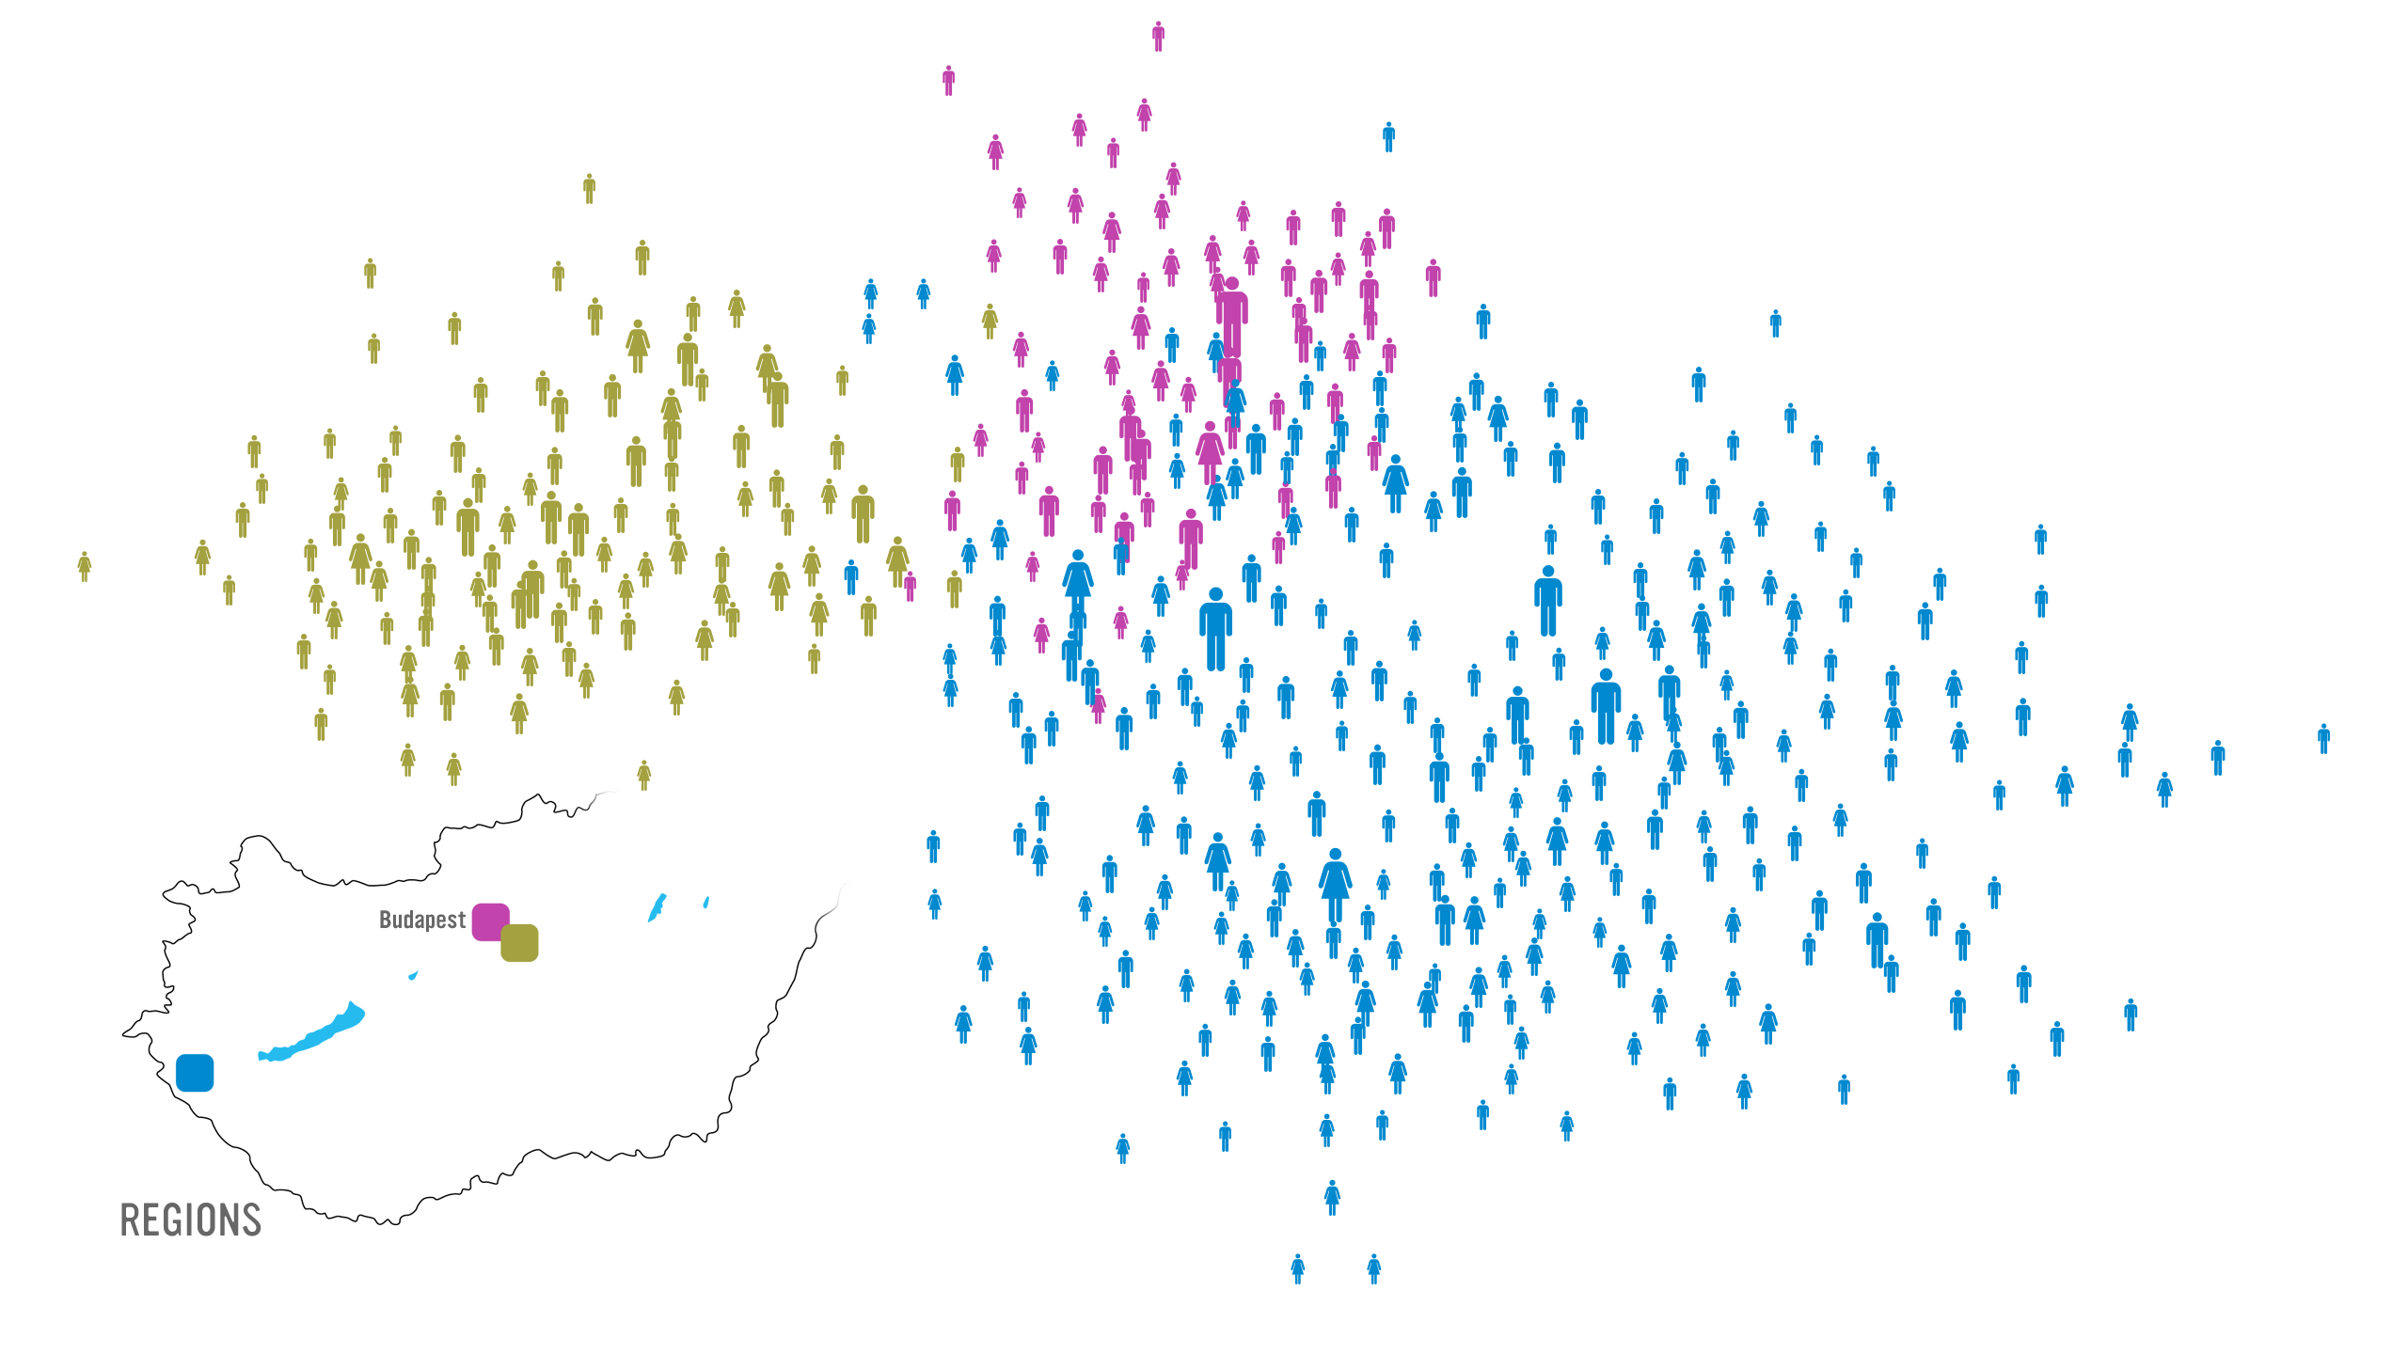

Management
Barabasi Lab
Notes:
While traditionally management uses the official chain of command to understand the inner structure of an organization, it is increasingly evident that the informal network, capturing who really communicates with whom, matters even more for the success of a company. Accurate maps of this network can expose lack of communication between key units, can identify individuals who play an outsize role in bringing different departments and products together, and help higher management diagnose diverse organizational issues. Furthermore, there is increasing evidence in the management literature that the position of an employee within this network correlates with his/her productivity [18].
Therefore, several dozen consulting companies have emerged with expertise to map out the true structure of an organization. Established consulting firms, from IBM to SAP, have added social networking capabilities to their consulting business. These companies offer a host of services, from identifying opinion leaders to preventing employee churn and from identifying optimal groups for a task to modeling product diffusion (Image 1.10a/b/c/d). Hence lately network science tools are increasingly indispensable in management and business, enhancing productivity and boosting innovation within an organization.
Network science can therefore offer a microscope for higher management, helping them improve the company’s effectiveness by uncovering the true network behind any organization.
30 Let me show you how this works. Start from the list of a company’s employees, colored based on their location. This happens to be a Hungarian company that has three locations, one on Budapest and two others outside of the city.
This is not enough, however: To apply network science, we need a network: we need to know who listens to whom, who is asking for advice from whom. So a social network company, Maven 7, asked each employee: Whom do you ask for advice when it comes to decisions that impact the company, like, restructuring, advancement, and so on?

Slide 24
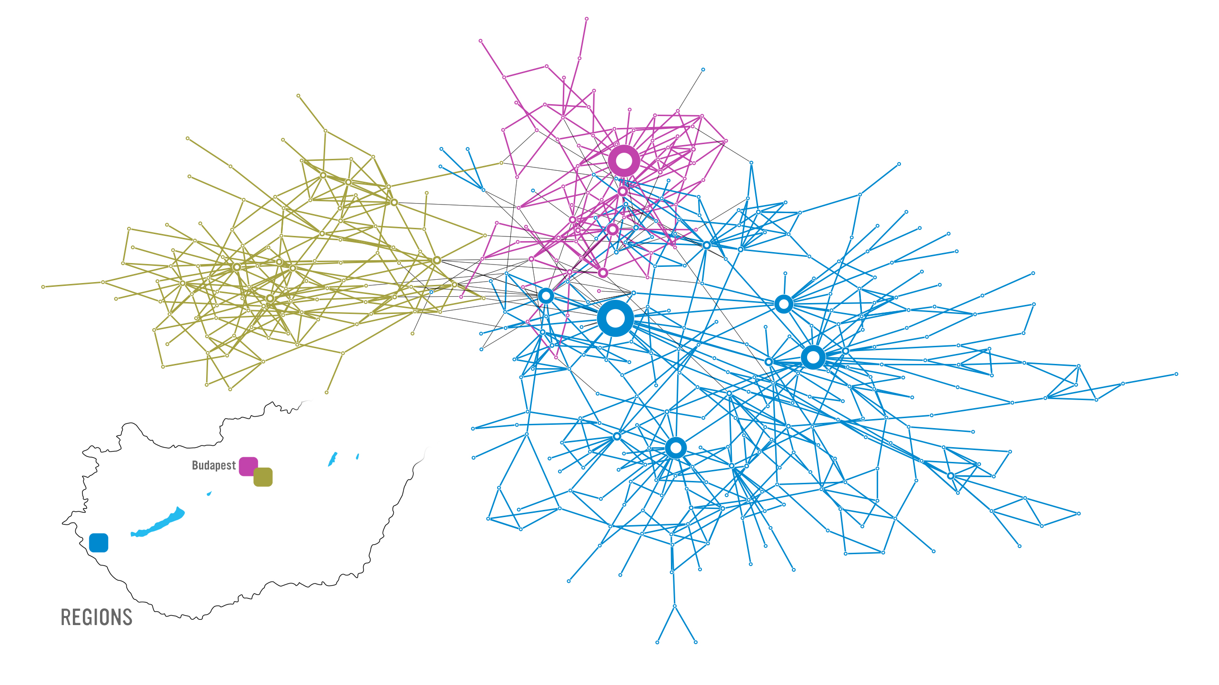
Barabasi Lab
Notes:
30 Why did they do map in the first place? The company had a major internal communication problem. The decisions of the higher management did not arrive to the workers, or what arrived had nothing do to with the real decisions. They wanted to find out where was the problem.
The map showed that several individuals do have quite a bit of influence in the company. They are the hubs. The problem was that none of the hubs were part of the leadership.

Slide 25
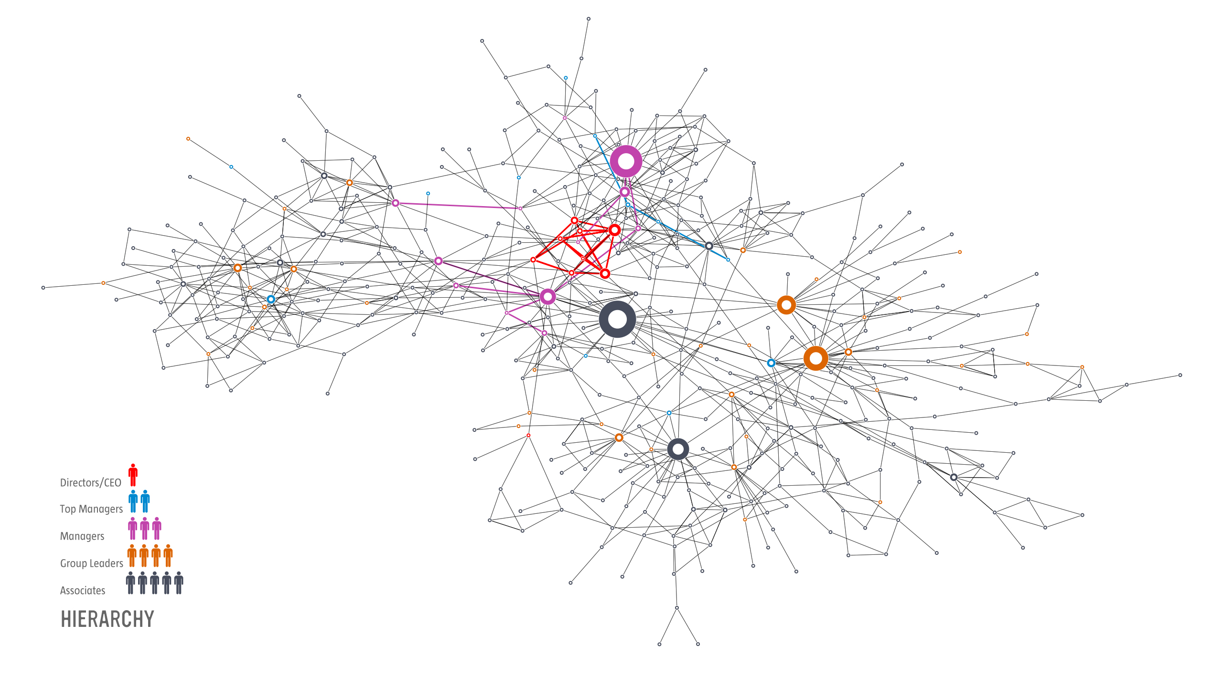
Barabasi Lab
Notes:
30: This is obvious here, where we colored the nodes based on their rank. The biggest hubs are not the company directors or the CEO. They are not part of the top management. Most are associates, a kind way to say, workers.
Who has the biggest influence? The safety and environmental manager. The only person whose job was to visit each location and talk with everyone. He had no links to the higher management. He was passing on information as collected along his trail. He was the oracle, running a gossip center.
So fire the guy? Well, he is not the problem. The problem is that higher management failed to put in place proper channels of communication, leaving behind a structural hole, which this fellow filled in.
But what does this have to do with control?

Slide 26
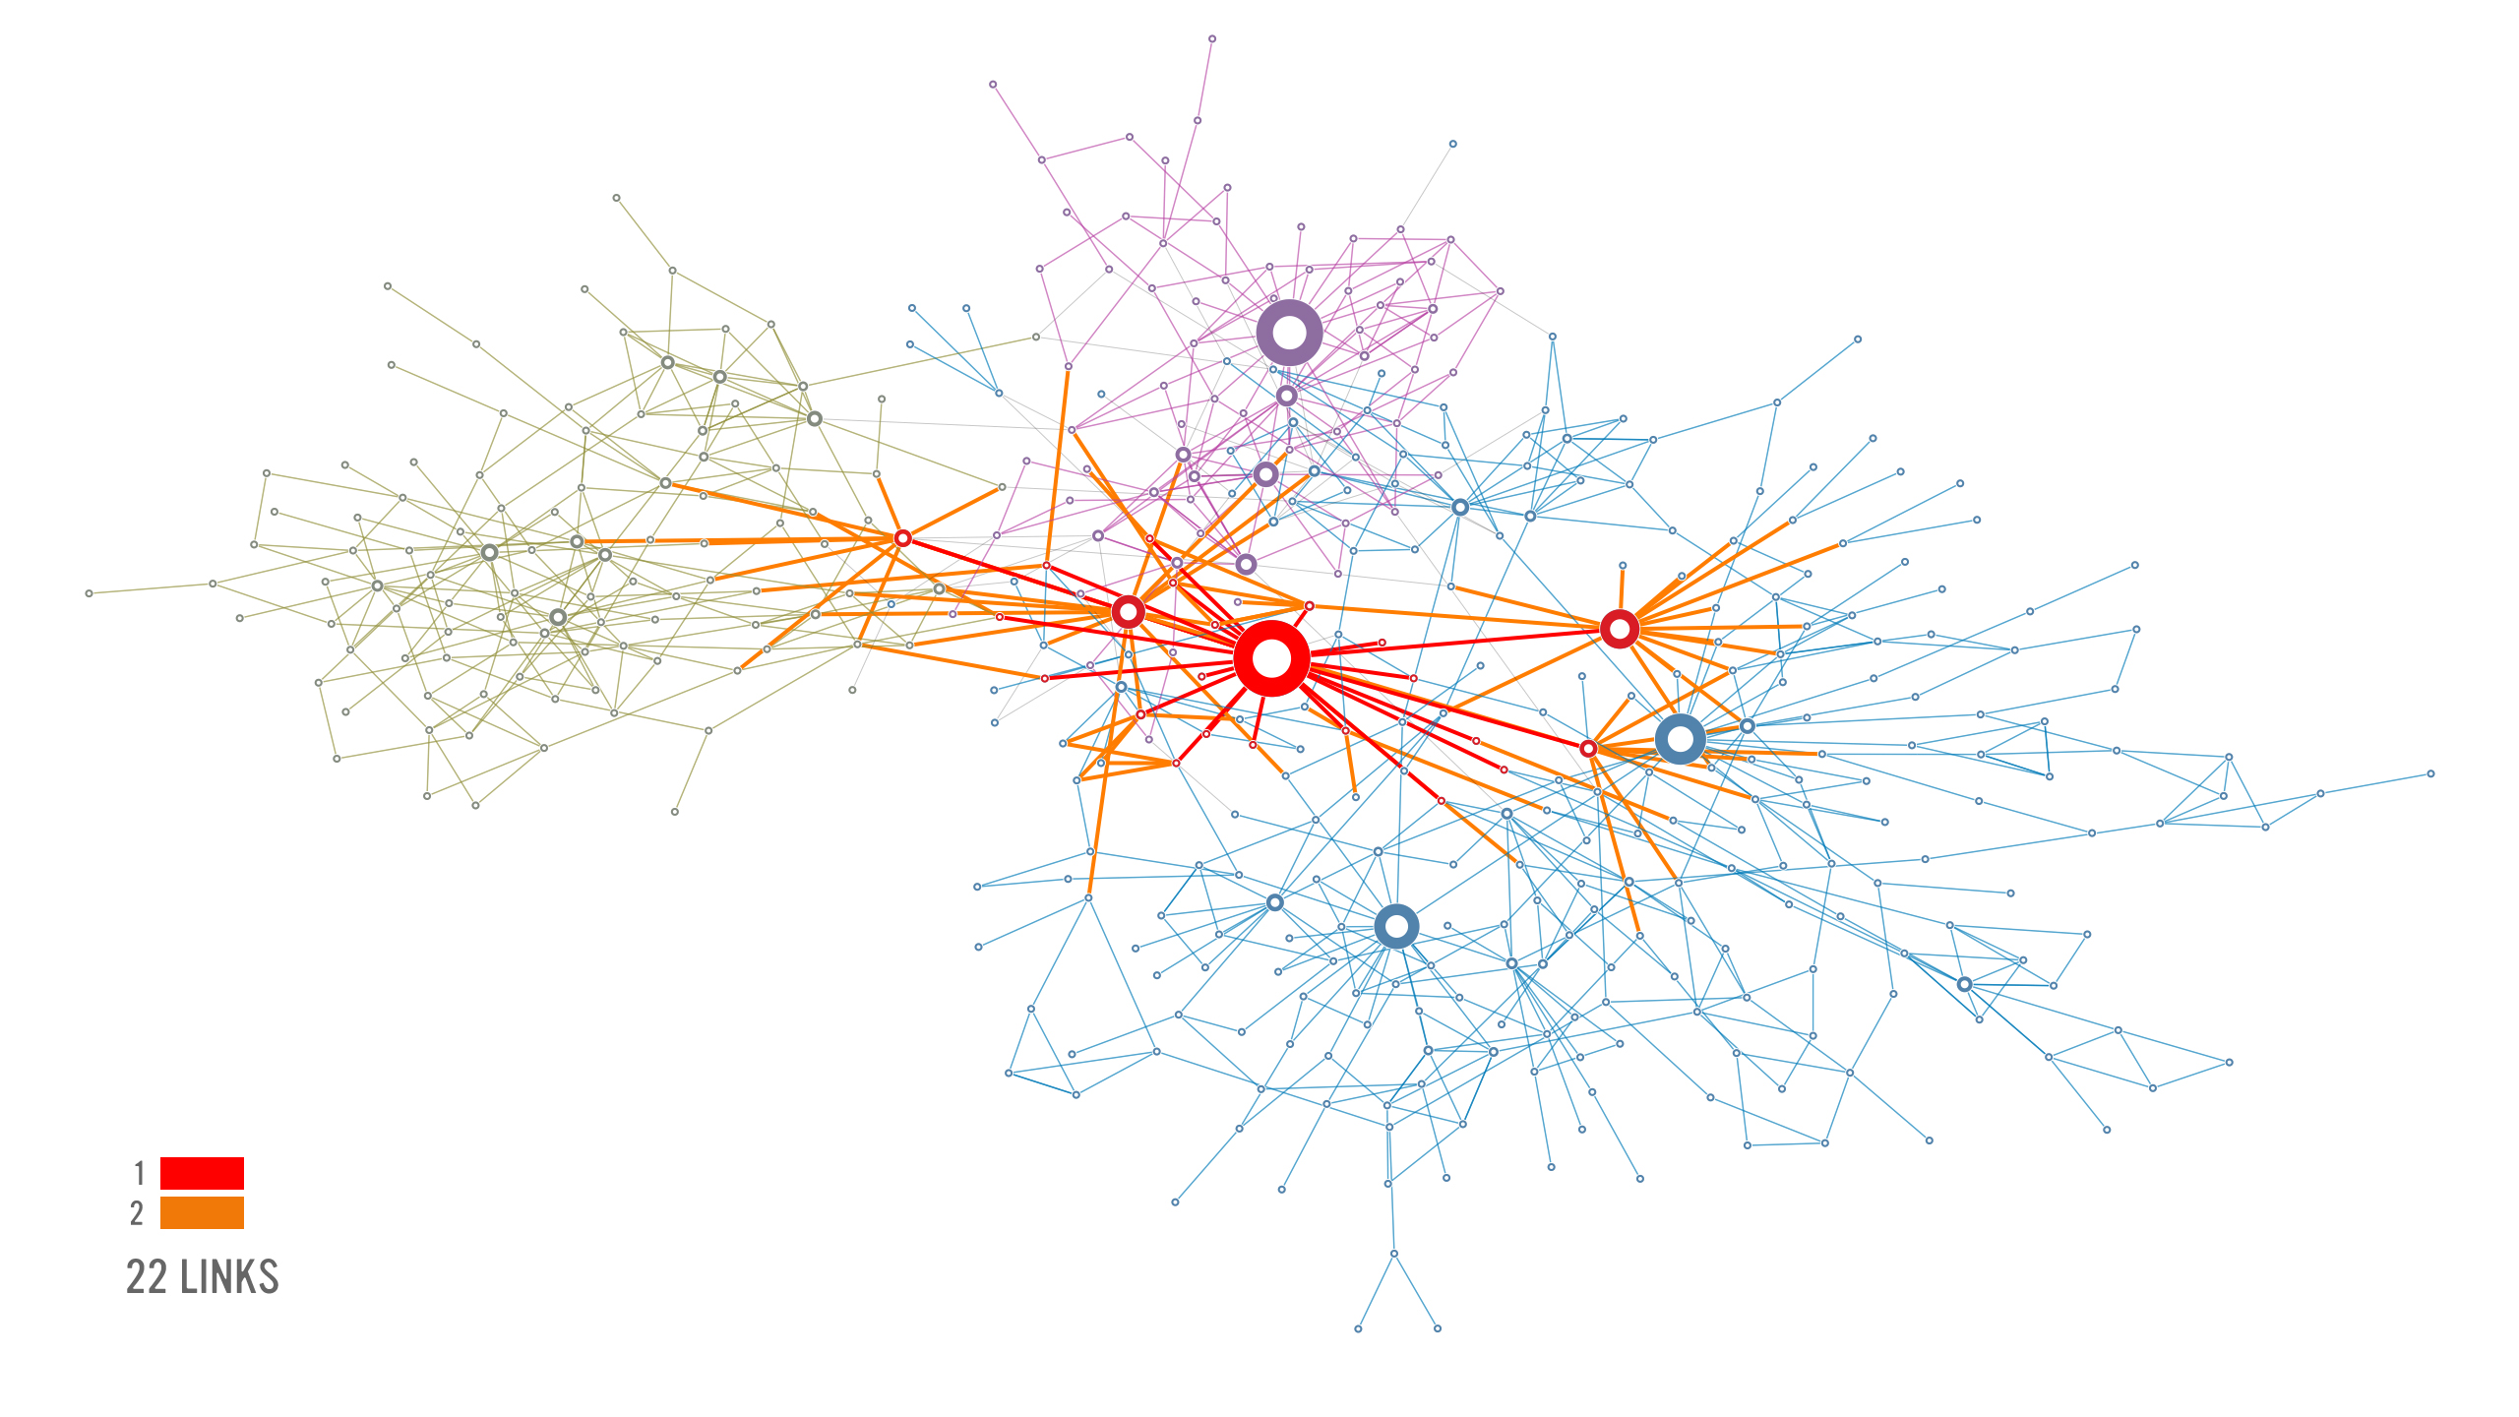

Slide 27
Section 1
The Bridges of Konigsberg

Slide 28
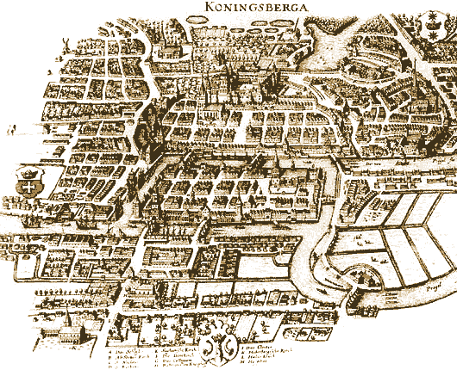
THE BRIDGES OF KONIGSBERG
Can one walk across the seven bridges and never cross the same bridge twice?
Network Science: Graph Theory
http://www.numericana.com/answer/graphs.htm
Notes:
Few research fields can trace their roots to a single moment and place in history. Graph theory, the mathematical scaffold behind network science, can. Its roots go back to 1736 to Konigsberg, a thriving merchant city in Eastern Prussia. Its busy fleet of ships and the trade they brought allowed city officials to build seven bridges across the river Pregel that surrounded the town. Five of these connected the elegant island Kneiphof, caught between the two branches of the Pregel, to the mainland;
two crossed the two branches of the river. This peculiar arrangement gave birth to a contemporary puzzle: Can one walk across all seven bridges and never cross the same one twice? Despite many attempts, no one could find such path. The problem remained unsolved until 1736, when Leonard Euler, a Swiss born mathematician, offered a rigorous mathematical proof that such path does not exist.

Slide 29
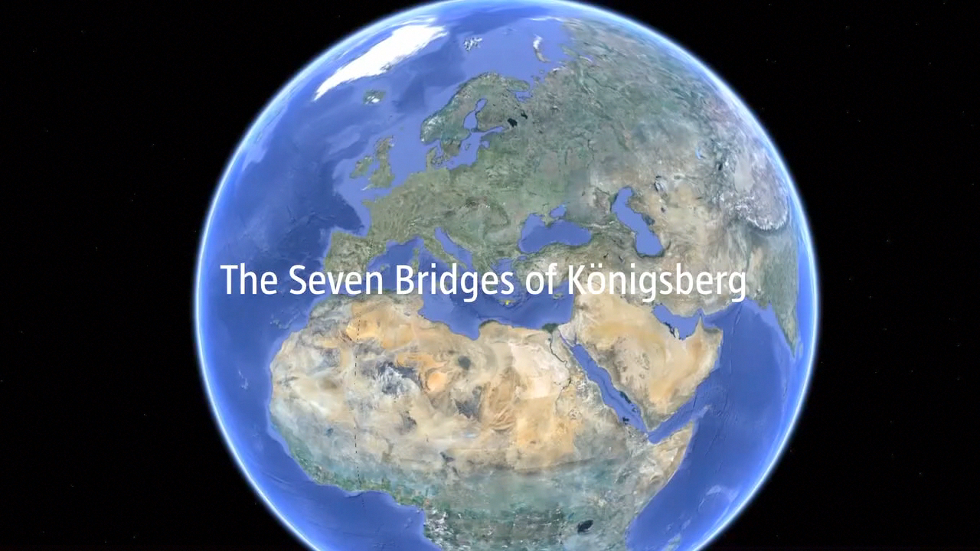
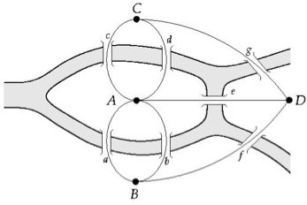
THE BRIDGES OF KONIGSBERG
http://www.numericana.com/answer/graphs.htm
Can one walk across the seven bridges and never cross the same bridge twice?
1735: Euler’s theorem:
If a graph has more than two nodes of odd degree, there is no path.
If a graph is connected and has no odd degree nodes, it has at least one path.
Network Science: Graph Theory
Notes:
Euler's insight was to represent each of the four land areas separated by the river as nodes, distinguishing them with letters A, B, C, and D. Next he connected with lines each piece of land that had a bridge between them. He thus built a {graph}, whose {nodes} were the pieces of land and {links} were the bridges. Then Euler made a simple observation: if there is a path crossing all bridges, but never the same bridge twice, then nodes with odd number of links must be either the starting or the end point of this path. Indeed, with an odd number of links you can arrive to a node and have no unused link for you to leave it. Yet, a continuous path that goes through all bridges can have only one starting and one end point. Thus such a path cannot exist on a graph that has more than two nodes with an odd number of links. As the K\"{o}nigsberg graph had three such nodes, B, C, D, each with three links, no path could satisfy the problem.
Today we remember Euler's proof because it was the first time someone solved a mathematical problem by turning it into a graph. In hindsight the proof has two important messages:
1. Some problems become simpler and more treatable if they are represented as a graph.
2. The existence of the path does not depend on our ingenuity to find it. Rather, it is a property of the graph. Indeed, given the layout of the K\"{o}nigsberg bridges, no matter how smart we are, we will never find the desired path.
in 1875 built a new bridge between B and C, increasing the number of links of these two nodes to four
In other words, networks have properties, hidden in their structure, that affect the function of the system they describe, limiting or enhancing our ability to do things with or on them. To fully understand how networks affect the properties of a system, we need to become familiar with some basic concepts in graph theory, encountering the language and mathematical formalism that will be of direct use throughout this book.

Slide 30
Section 2
Networks and graphs

Slide 31
COMPONENTS OF A COMPLEX SYSTEM
components: nodes, vertices N
interactions: links, edges L
system: network, graph (N,L)
Network Science: Graph Theory

Slide 32
NETWORKS OR GRAPHS?
network often refers to real systems
www,
social network
metabolic network.
Language: (Network, node, link)
graph: mathematical representation of a network
web graph,
social graph (a Facebook term)
Language: (Graph, vertex, edge)
We will try to make this distinction whenever it is appropriate, but in most cases we will use the two terms interchangeably.
Network Science: Graph Theory

Slide 33

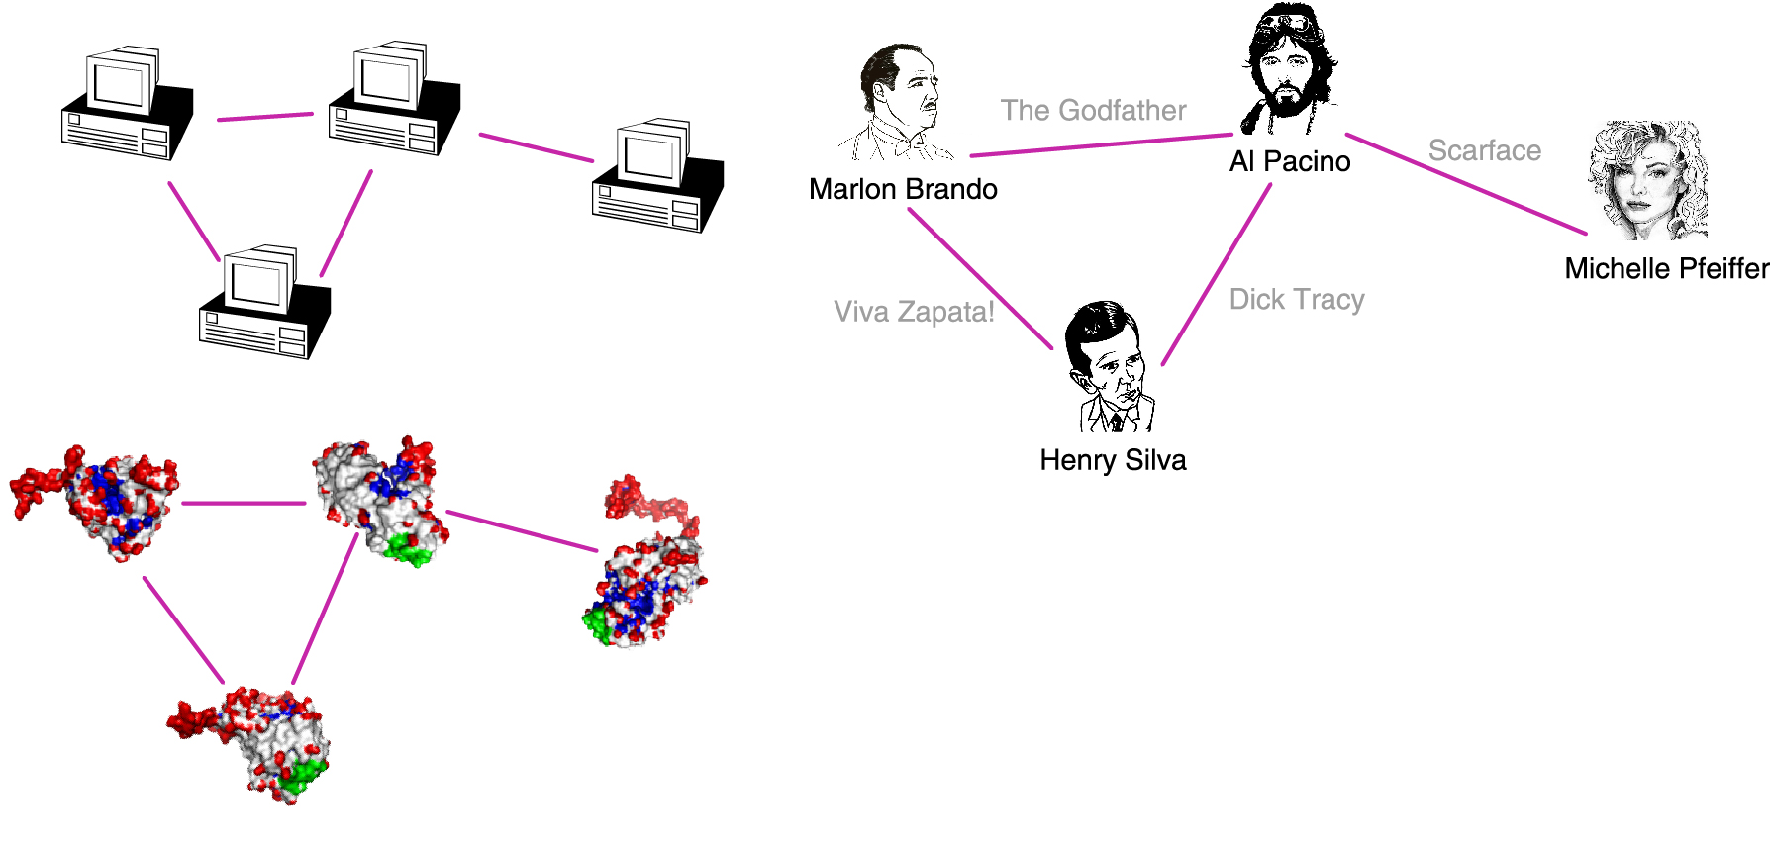
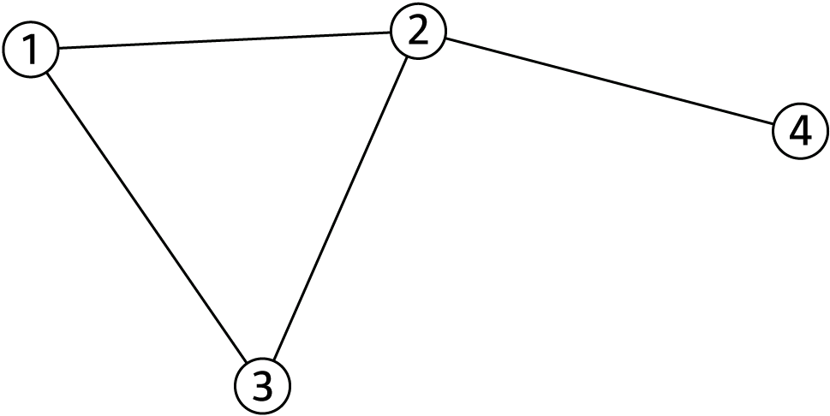
A COMMON LANGUAGE
N=4
L=4
Network Science: Graph Theory

Slide 34
CHOOSING A PROPER REPRESENTATION
The choice of the proper network representation determines our ability to use network theory successfully.
In some cases there is a unique, unambiguous representation.
In other cases, the representation is by no means unique.
For example, the way we assign the links between a group of individuals will determine the nature of the question we can study.
Network Science: Graph Theory

Slide 35
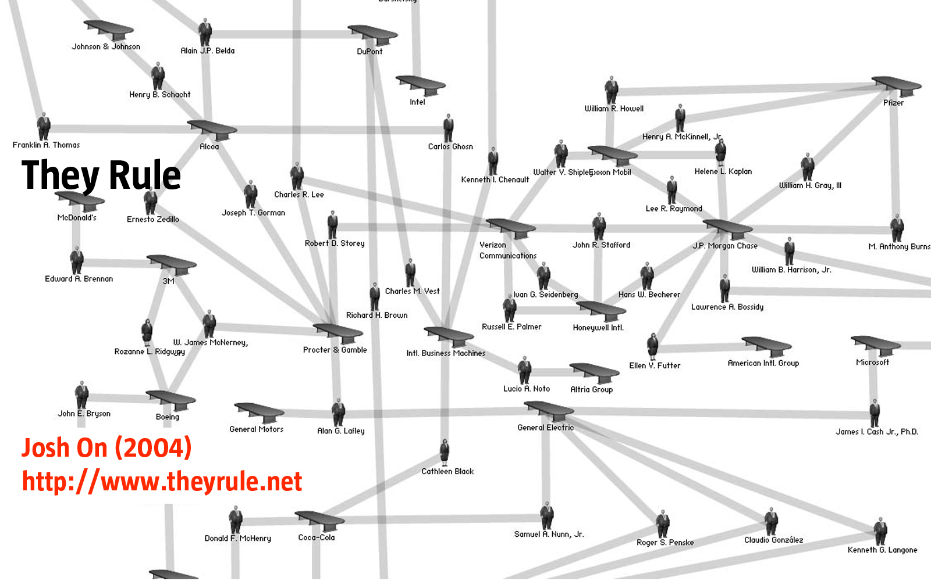
CHOOSING A PROPER REPRESENTATION
If you connect individuals that work with each other, you will explore
the professional network.
Network Science: Graph Theory

Slide 36
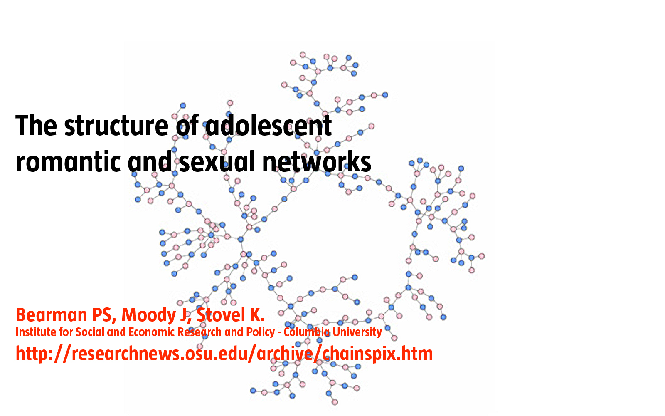
CHOOSING A PROPER REPRESENTATION
If you connect those that have a romantic and sexual relationship, you will be exploring the sexual networks.
Network Science: Graph Theory

Slide 37
CHOOSING A PROPER REPRESENTATION
If you connect individuals based on their first name (all Peters connected to each other), you will be exploring what?
It is a network, nevertheless.
Network Science: Graph Theory

Slide 38

Network Science: Graph Theory

Slide 39
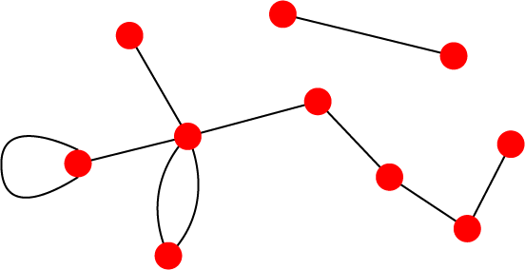
UNDIRECTED VS. DIRECTED NETWORKS
Undirected
Directed
Links: undirected (symmetrical)
Graph:
Links: directed (arcs).
Digraph = directed graph:
L
A
D
F
M
B
An undirected link is the superposition of two opposite directed links.
C
I
D
B
G
E
G
H
A
C
F
Undirected links :
coauthorship links
Actor network
protein interactions
Directed links :
URLs on the www
phone calls
metabolic reactions
Network Science: Graph Theory
Notes:
A key property of each node is its degree, representing the number of links it has to other nodes. The degree can represent the number of mobile phone contacts an individual has in the call graph (i.e. the number of different indivi uals the person has talked to), or the number of citations a research paper gets in the citation network.
We denote with ki the degree of the ith node in the network.

Slide 40
Section 2.2 Reference Networks

